Slide 1

Data Scientist Stream Part 1
Day 3
DATA EXPLORATION WITH PYTHON
By
Ms. Nur Hurriyatul Huda Abdullah Sani and Mr. Ahmad Najmi Ariffin

Slide 2


Fun with Python
Hands-on:
http://bit.ly/dstreamDay03
What Can I Do With Python?

Slide 3



COURSE OUTLINE
04
Hands-on
http://bit.ly/dstreamDay3
Manipulating data using Pandas
03
Series, Data Frame
Loading data from a variety of common formats
02
Introduction to pandas
What is Pandas?
Basic syntax in pandas
csv, xlsx, html, json, sql.
01

Slide 4
BASIC PACKAGE IN PYTHON
NumPy
provides efﬁcient storage and computation for multi-dimensional data arrays
SciPy
contains a wide array of numerical tools such as numerical integration and interpolation
Pandas
provides a DataFrame object along with a powerful set of methods to manipulate, ﬁlter, group, and transform data
Matplotlib
provides a useful interface for creation of publication-quality plots and ﬁgures
Scikit-Learn
provides a uniform toolkit for applying common machine learning algorithms to data

Slide 5
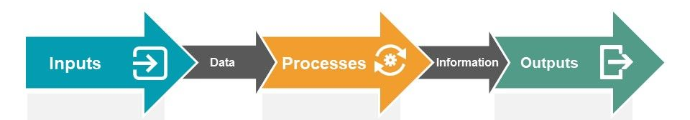
Understanding the Pandas IO API
http://bit.ly/dstreamDay03
Converter
dtypes
pd.read_csv()
pd.read_excel()
DataFrame object
Notes:
The Pandas I/O API is a set of top level reader functions accessed like pd.read_csv() that generally return a Pandas object.

Slide 6
Preparing Data : Scenario
Hands-on:
http://bit.ly/dstreamDay03
Country
Population
Gross domestic product
Continent
Independence day
Area
Notes:
data related to 20 countries

Slide 7
Loading data from a variety of common formats

Slide 8
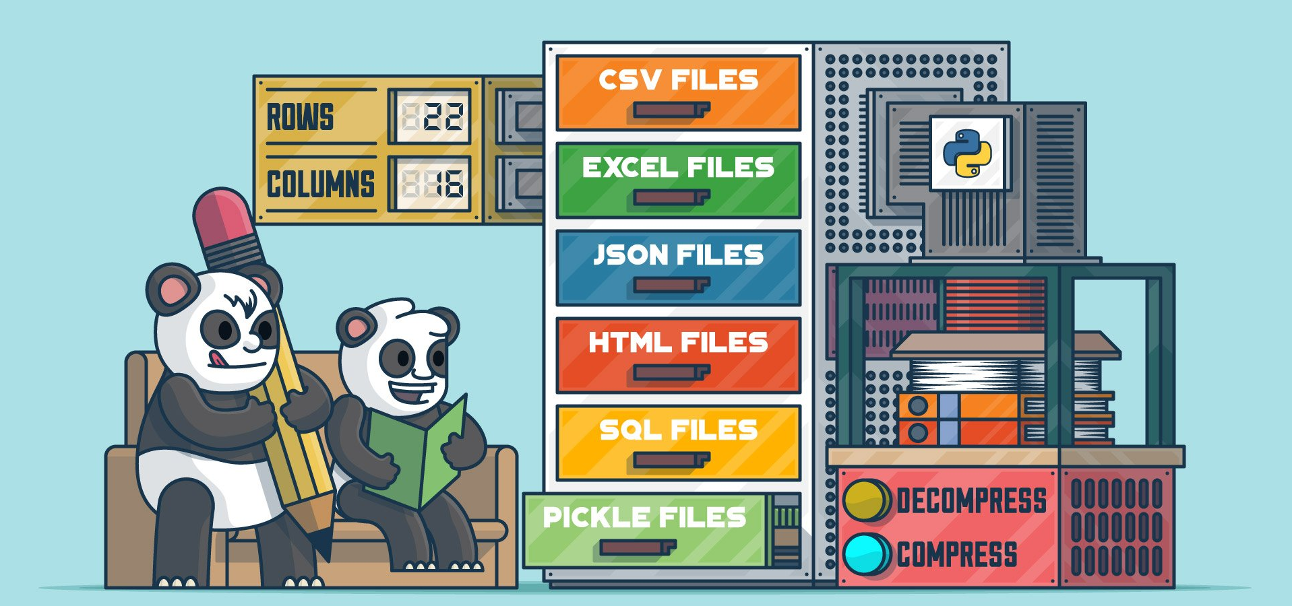
Working With Different File Types
http://bit.ly/dstreamDay03

Slide 9




Use Dataset from Various Sources
http://bit.ly/dstreamDay03
Load data from your local drive
Load data from your Google Drive
Load data from Github (Files < 25MB)

Slide 10
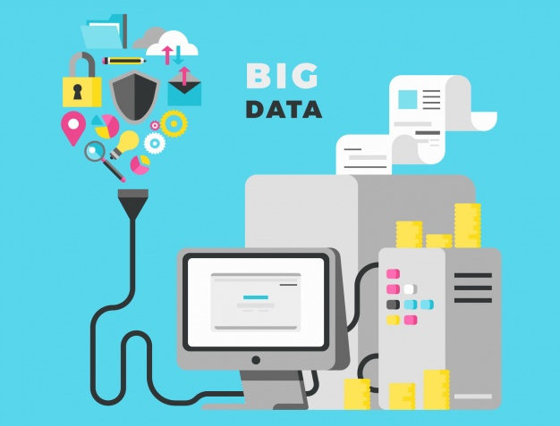
Working With Big Data
Hands-on:
http://bit.ly/dstreamDay03
CREATE
UPDATE

Slide 11
Manipulating data using Pandas

Slide 12


Series and Data Frame
01
Series
02
Data Frame
The first main data type we will learn about for pandas is the Series data type.
A Series is very similar to a NumPy array (it is built on top of the NumPy array object).
What differentiates the NumPy array from a Series?
is that a Series can have axis labels, meaning it can be indexed by a label, instead of just a number location.
It also doesn't need to hold numeric data, it can hold any arbitrary Python Object
One basic structure that you get with pandas is a data frame.
A data frame is a two dimensional grid, rather similar to a relational database table except in memory.
Data Frames are the workhorse of pandas and are directly inspired by the R programming language.
We can think of a Data Frame as a bunch of Series objects put together to share the same index

Slide 13
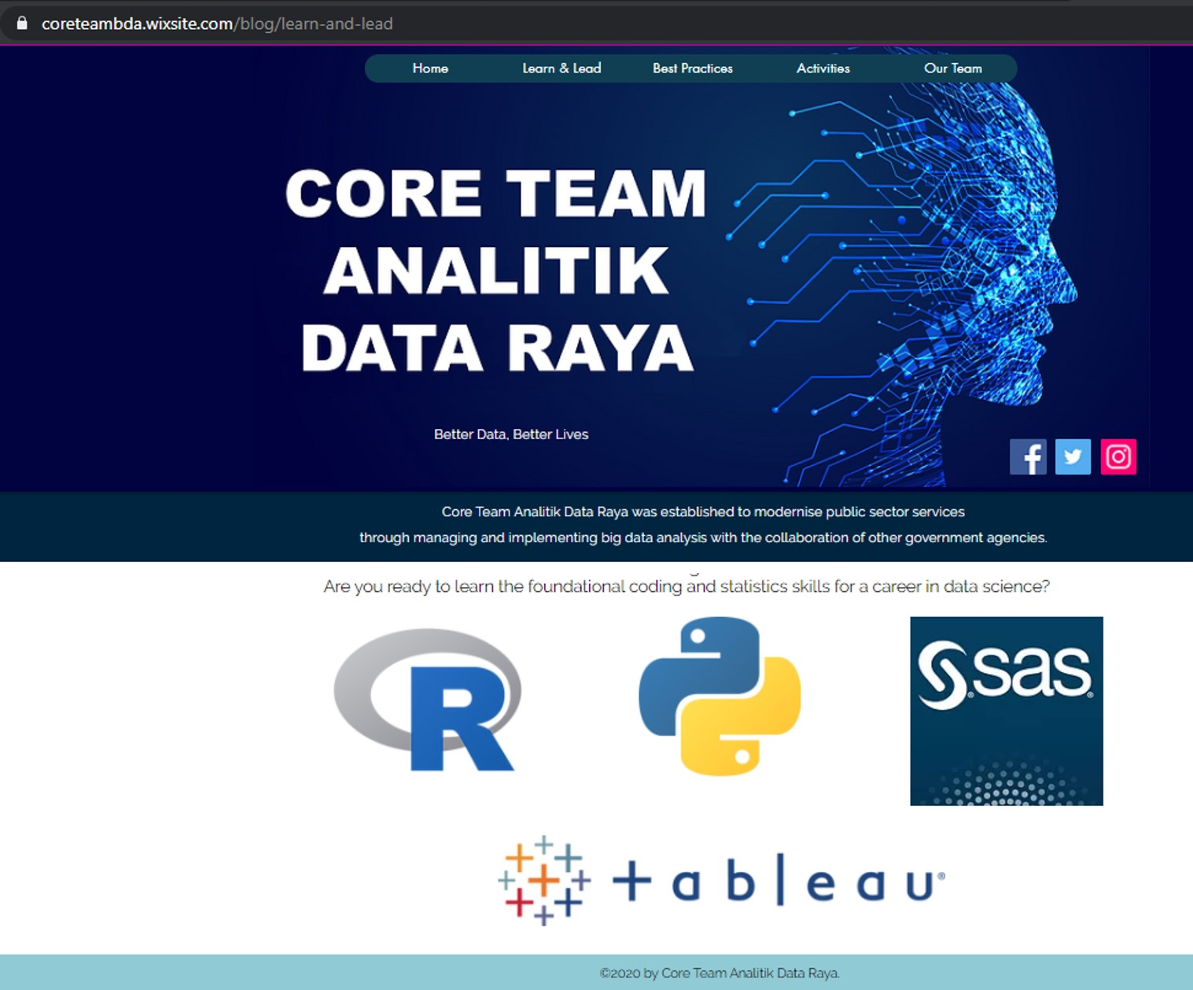
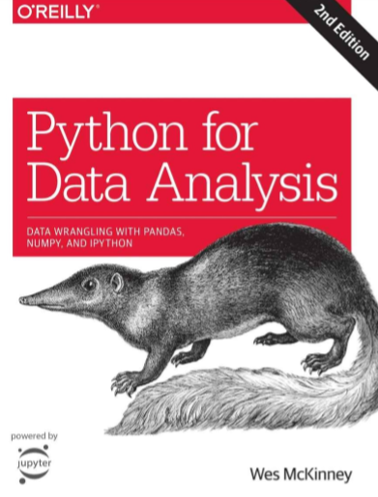

Some useful references
https://coreteambda.wixsite.com/blog/learn-and-lead

Slide 14

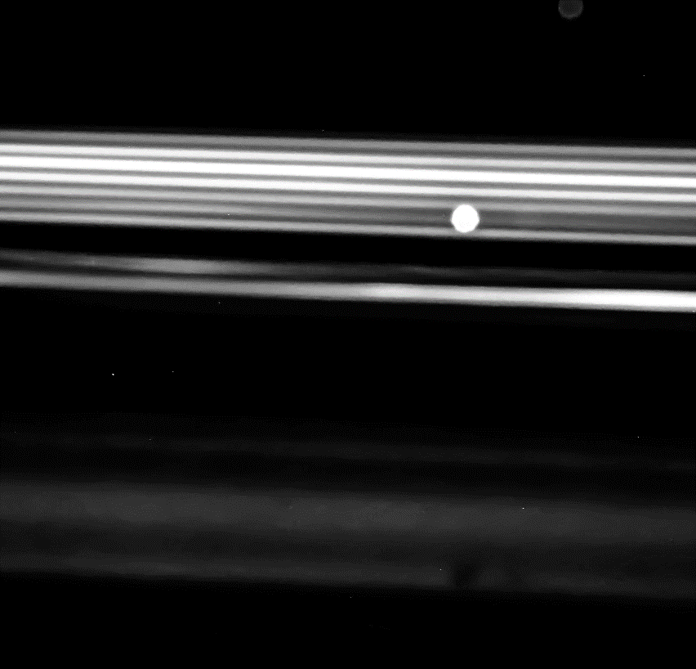


Let's explore this concept through some examples:

